Slide 1
Business Logo
Leading Teams
[Business Name]
Presented by:
Thomas Faulkner, MBA
Notes:
Bianca Allen, RN, CV-BC, CRAT

Slide 2
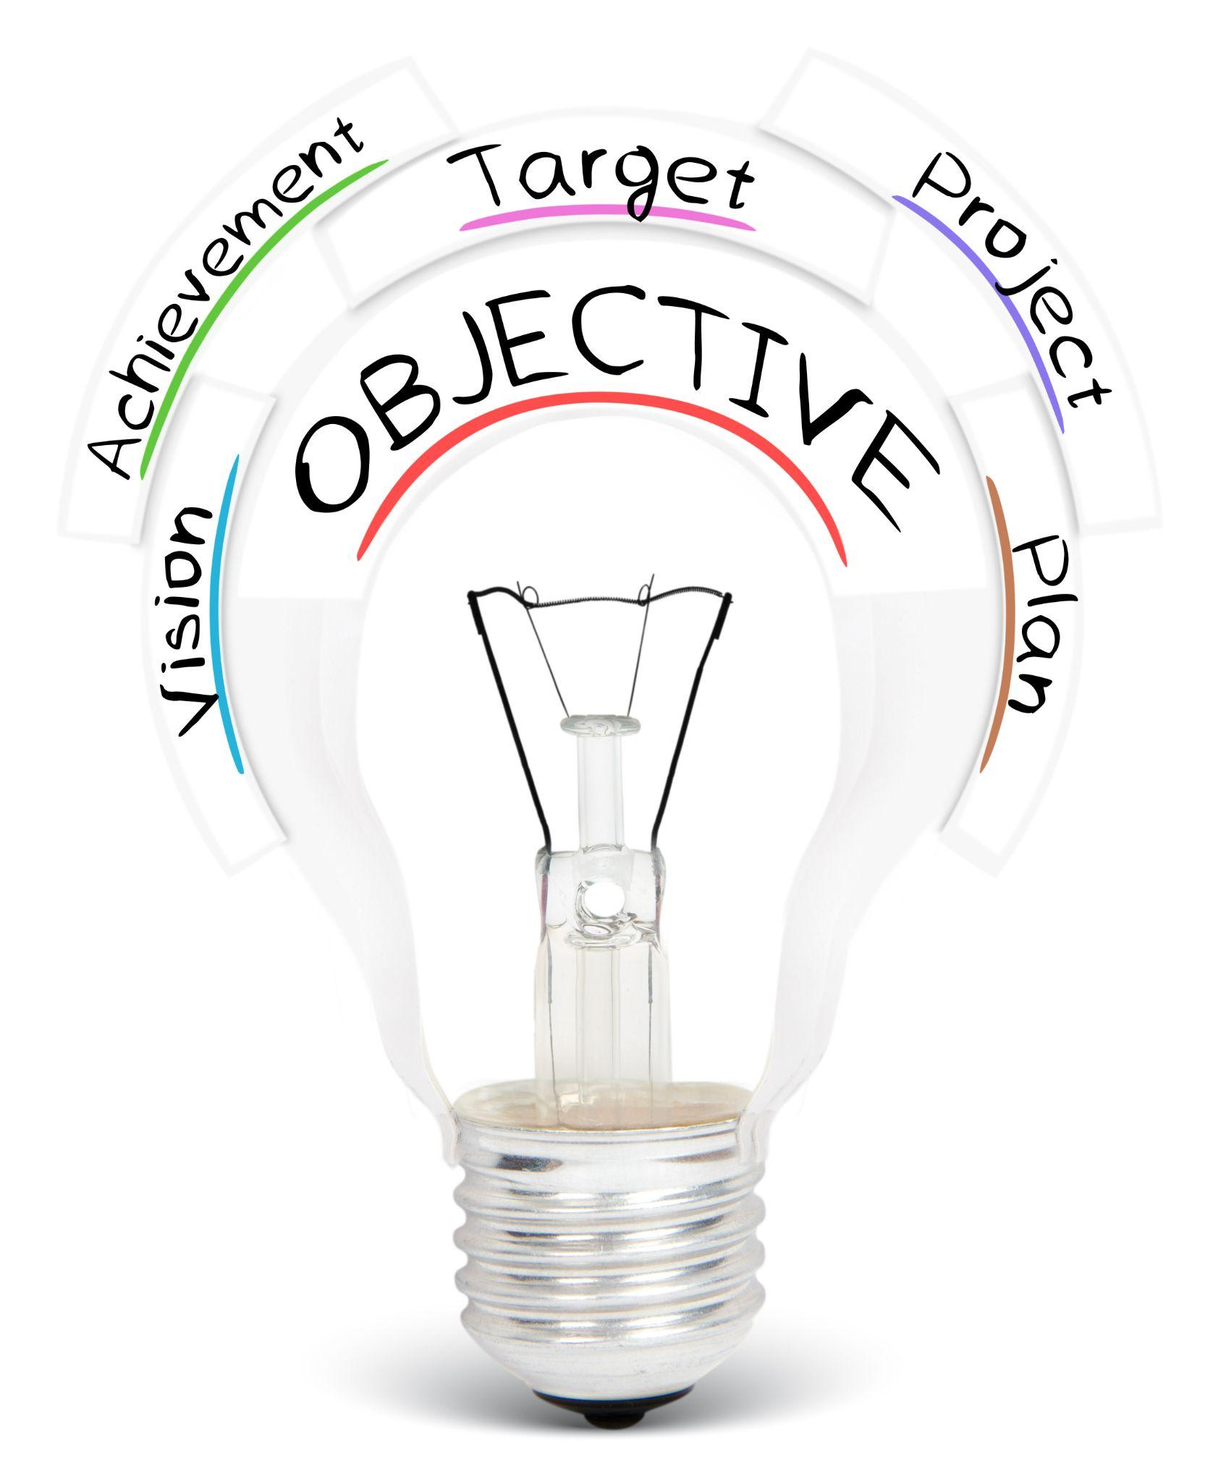
Team Objectives
Identify common areas for opportunity related to communication and accountability in teams
Research evidence-based practices and implement
strategies to aid in improving communication and accountability
Develop and implement communication and
accountability processes to create a more efficient workflow in teams

Slide 3

Problem Scenario: Intro
A team meeting was requested by several employees working on a group project to clarify roles and to address the accountability and communication issues they were experiencing while working on an employee relations project in the HR Department. A mid-level professional, Omar, shares with you, the Project Manager, that he feels frustrated at the pace that work is being completed and that “everyone else gets to slack off and do whatever they want but we always have these meetings and where we try to get things realigned and it never solves anything.” Omar states that his largest frustration stems from his working relationship with a peer, Debra, who he felt wasn’t as qualified because she was only an intern.
Notes:
(Read the scenario outloud.)
This scenario provide the context in which we will further explore the bounds and depths of the core problems associated with leading teams amid conflict and offer solutions on how to promote an effective and collaborative solution to working as a cohesive whole. Now that we have identified the scenario we will be exploring in this presentation, let us transition into looking a bit more comprehensively at the nature of this problem. -TF

Slide 4
Problem Scenario: Progression
Debra shares with you that she feels intimidated by Omar’s presence and that she often “loses the motivation to work when he comes over and practically yells at me on how he wants things done.” Debra shared that she believed that the meeting request stemmed from a conversation she had with Omar in which she mentioned that he was “not my boss and we all have things we need to do without you barking at everyone.” Omar has since been using passive aggression in his professional emails and communication with team mates and has made outward statements to team members criticizing Debra’s and several other interns work on this project.
Notes:
(Read the scenario outloud.)
This scenario provide the context in which we will further explore the bounds and depths of the core problems associated with leading teams amid conflict and offer solutions on how to promote an effective and collaborative solution to working as a cohesive whole. Now that we have identified the scenario we will be exploring in this presentation, let us transition into looking a bit more comprehensively at the nature of this problem. -TF

Slide 5
Problem Scenario: Climax
At this point in the project, the team is not working efficiently: much of the work is either bottlenecked by conflict or being created twice with team roles being confused and peers acting as delegates to the Project Manager. The Project Manager must intervene to ensure the project is completed on time.
Notes:
(Read the scenario outloud.)
This scenario provide the context in which we will further explore the bounds and depths of the core problems associated with leading teams amid conflict and offer solutions on how to promote an effective and collaborative solution to working as a cohesive whole. Now that we have identified the scenario we will be exploring in this presentation, let us transition into looking a bit more comprehensively at the nature of this problem. -TF

Slide 6

Problem Statement Topics
Communication and Accountability
Communication-There are communication barriers that are happening within this work place. Uncompleted task are not being communicated to team effectively and it causes task to not get done or being completed inaccurately.
Accountability-There is little to no accountability when working in teams. Team members tasks are often incomplete or not done in a timely matter.
Notes:
VM-There are many communication barriers affecting the workflow, There is no accountability from employees or management.

Slide 7

Problem Statement
Communication
We must learn the barriers that are causing the team members to not have effective communication within the workplace.
We must also learn new ways to fix these barriers within this organization with new research.
Notes:
VM-We must learn what is causing the workplace to have communication barriers. The workplace should always have effective communication in the workplace to avoid mistakes or task being completed wrong.

Slide 8
Problem Statement
Accountability
We must learn new ways to make sure team member’s tasks are complete and done in a timely manner.
We must figure out what is causing team members to have no accountability in the workplace.
We must come up with a solution to help team members be more accountable when getting assigned tasks.
Notes:
Management should be holding staff accountable in order for tasks to be completed on time.

Slide 9

Analysis of Problem
Communication
Passive Aggression
Divisive Subculture
Hostile Work Environment
Conflicting Roles
Accountability
Allocation of Work
Work redundancy
Missing objectives
Silos Forming
Motivation
Mistrust in Team Diversity/Qualifications
Notes:
A comprehensive analysis of the problem was conducted by the agency’s internal review team and it was determined that significant issues arose from the initial conflict concerning the interpersonal relationships between peers within the group. This has caused a disruption in how effective business processes are being observed and the overall quality of work that is being output at the varying stages throughout the project.
The communication among team members plays an integral role in how efficient teams are structured and come together to create a cohesive, unified project. In the scenario we note that the passive aggressive behaviors demonstrated by Omar are creating some internal conflicts in how effective the team is at meeting deadlines and completing overall tasks. Passive aggressive behaviors have an intense negative affect within an organization which leads to teams and groups experiencing delays in the decision-making process and eroding the foundation of trust amongst group members (Davey, 2016). This in turn can create a divisive subculture within teams and groups that wittles down the effective procedures and protocols that were set at the groups genesis and allows for power and influence to be shifted across peers if left unchecked.
Accountability issues are also mirrored in the provided scenario as a means of an existing problem rises together with the other problem domains spoken about in the communications section. When the group experienced concerns communicating within the team, it became apparent that a quick decline in productivity was observed. Firstly, when roles were confused, the team noted that work operations began to take shape of silos forming within the team. While some work was being completed, most of the output was doubled where multiple people were working on the same objectives while other aspects of the project were left neglected. From the conflict resolution lens, the motivation to pull away from the team observed by Debra and the other interns elicits mistrust among the members and calls upon the questioning of others in the team to feel as if they must choose sides. -TF

Slide 10

Analysis of Problem(cont.)
Conflict Resolution is NECESSARY in this situation to ensure that:
Team members feel valued and respected.
Clear roles and responsibilities are defined to minimize conflict.
Workers have clear expectations about the project’s scope and how it is properly divided.
Ownership and Responsibility are being observed in all assigned project tasks and assignments.
What are some effective strategies for leaders to adopt in order to lay the foundation down for effective teams?
Notes:
To summarize, it is more than acceptable to acknowledge that a conflict resolution plan must be developed in order for the Project Manager to retake control of the situation and re-establish clear and effective goals for the team. This in turn will lead to team members feeling a greater sense of value and respect among their peers and ensure that feelings of safety and inclusion are fostered among group members. We will also see that as roles and responsibilities are defined, so too will be the expectations of how work is divided and how ownership and accountability are assumed in assigned work details. -TF

Slide 11
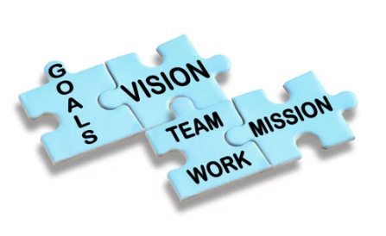
Best Practices-
High Performing Teams
Shared Vision and Values
Ownership and Accountability
Open/Clear Communication
Mutual Trust and Respect
Effective Conflict Resolution
Notes:
High-functioning teams have key characteristics and behaviors that drive creativity, innovation, cohesiveness, and results. For a team to be successful, they must have a shared goal and vision, display ownership and accountability, communicate effectively, have trust and respect for one another and resolve conflicts effectively (Satell, Windschitl 2021).

Slide 12

Shared Vision/Values
Shared values and goals boost team synergy. The team has uniform goals and objectives. Members are intrinsically motivated to meet performance metrics.
Key Factors
Sense of Purpose
Actionable Values
Aligned Priorities
W.I.G.S
Harmony
Win-Win
Congruence
Notes:
Teams that have shared values and goals operate in harmony and collectively are committed to the desired outcome. This culture enhances productivity and motivation. Intrinsic motivation guides a person's behaviors based on personal aspirations and yearning for success (Channeski, 2014). Teams flourish when each team member has the same innate desire to achieve the same goals. Priorities are quickly identified, and the team works collaboratively to ensure its success (Satell, Windschitl 2021).

Slide 13
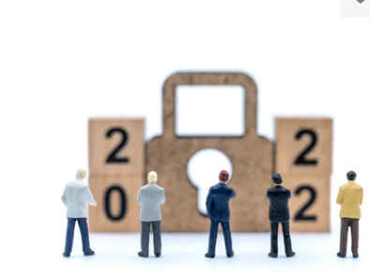
Ownership/Accountability
Accountability and Ownership of individual responsibilities and team goals promote a positive team culture. A strong team has clear expectations for performance, and all members are dedicated to meeting them.
Key Factors
Owning Outcomes
Objective Feedback
Proactive Leadership
Results Driven
Resilience
Integrity
Notes:
A strong team has a high sense of individual and team ownership and accountability. Self-accountability builds trust and positive working relationships amongst the group and creates an environment of excellence. When all team members accept ownership and responsibility for decisions and outcomes, goals are more easily met, and potential challenges are proactively solved (Channeski, 2014). Team accountability is also essential. Respectfully holding peers accountable for mutually agreed-upon goals and objectives builds courage and strengthens the team (Todorova, 2019).
Bianca Allen, RN, CV-BC, CRAT

Slide 14

Clear/Open Communication
Effective communication is vital for team success. Enhances productivity and helps guide team collaboration.
Key Factors
Knowledge Sharing
Communication Styles
Honest Feedback
Respectful Encounters
Timeliness
All Team Members
Difficult Conversations
Notes:
Knowledge and information sharing are essential to a team's cohesiveness and unity. A team that functions at a high level has strong communication skills(Guttman 2008). The team must understand all members preferred communication styles and ensure they have the psychological safety to express ideas, concerns, and setbacks and be able to ask for help (Hagemann, 2012). Doing this ensures information can be passed seemingly to the appropriate person with its desired intent. Communicating frequently and respectfully allows teams to work through conflicts, give and receive essential feedback, and progress toward the goal or vision (Guttman 2008). Honesty and transparency build trust amongst peers and can renew confidence in the team's ability to succeed. A team is unlikely to succeed if communication is ineffective.

Slide 15

Mutual Trust /Respect
Strong teams have mutual trust and respect. Each member feels valued and supported. This promotes cohesiveness, and camaraderie increases motivation and produces high levels of commitment.
Key Factors
Vulnerability
Promotes Healthy Risk-Taking
Built Over Time
Requires Consistency and Effort
Value Difference
Commitment to Coworkers
Benefit of the Doubt
WGU
Notes:
Respect and trust provide the strong foundation a team needs to be successful. Respecting a person's individuality, skill set, and differences builds appreciation and facilitate connection and a sense of belonging (Todorova, 2019). Decisions and interactions amongst teammates are guided by the other person's best interest and desire to see them succeed. Mutual trust and respect allow teams to take calculated risks, feel supported and build courage (Nelson, 2010).

Slide 16

Conflict Resolution
Effectively working through conflict builds trust and draws teams closer together. Differences are valued, and compromise is achieved through common ground and mutual respect.
Key Factors
Psychological Safety
Early Interventions
Transparent Communication
Redefining Goals
Empathy and Grace
Shared Understanding
Root Cause Analysis
Objective Observations
Healthy Boundaries
Notes:
Effective conflict resolution is an essential component of high-functioning teams. When problems arise, the team can quickly identify the areas of concern and work together to reach a compromise and Win-Win for the group (Satell, Windschitl 2021). Conflict resolution is an advanced skill in teams. It often requires the team to incorporate the other skill sets such as open communication, focusing on shared goals and common ground, and the commitment they have to each other to resolve it. Teams with the tools to work through tension can easily move roadblocks and continue without animosity or negative feelings (Hagemann, 2012).

Slide 17

Proposal
Project Manager will meet with the team to address the current barriers that are hindering progress.
Communication
Project Manager will conduct an education series mandatory for all team members to provide training and education on conflict management and provide resolution strategies.
Training will be held in a two-part series.
Notes:
Good communication in the workplace provides for better performance, enhanced productivity, and overall improved employee morale. Conflicts appear to be arising out of unclear task expectations, personality conflicts, disrespectful communication. -AM

Slide 18

Proposal
Conflict Management Resolution Special Session
Agenda
Affirm culture of safety
Set guidelines
Establish boundaries
Active/Empathic Listening
Clarification of issue
Separate meeting for Omar and Deborah after meeting individually
Clarify source of conflict
Notes:
PM will hold a special session meeting for all team members. The topic to be addressed will be conflict management resolution. Highlights on the agenda include safety culture, setting guidelines, and boundaries, listening skills, clarifying issues and areas of conflict, separate meeting for Omar and Deborah after meeting individually. - AM

Slide 19

Proposal
Agenda cont.
Identify solutions
Positive Reframing
Encourage Team Collaboration
Appointment of Team Mediator
Notes:
PM will continue meeting with agenda of identifying solutions, assisting team members to engage in positive reframing when communicating. A focus on team collaboration and building on one another’s strengths as they navigate the project. Lastly, a team mediator will be appointed to help facilitate as issues arise. - AM

Slide 20

Proposal
Secondary Meeting to Clarify Roles and Responsibilities
Agenda
Reaffirmation of project goals
Clear and consistent roles
Ownership and accountability structure
Determination of task ownership
End result
Due date
Communicating with assigned members
Notes:
PM will conduct secondary meeting in order to reaffirm the project goals, and establish clear expectations for all team members roles and responsibilities in the project. PM will determine and provide team members with a list of tasks they are responsible for, what the outcome will be, when they are due and how to communicate with team members as the project evolves. - AM

Slide 21
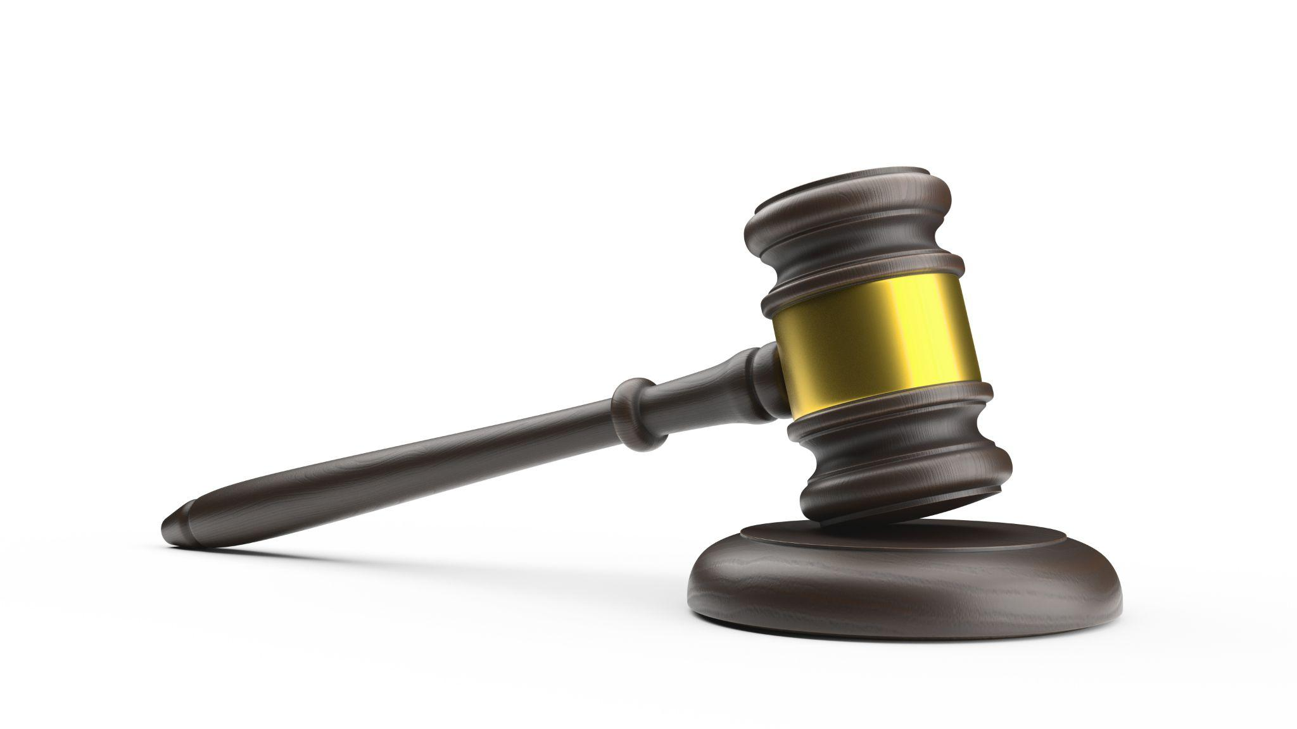
Conclusion
Highly Performing teams are found to have a foundation built on mutual trust and respect.
This foundation provides the avenue to clearly define roles and shared values and communicate effectively through conflict.
Ownership and Accountability of individual and team goals provide the roadmap to achieving the teams objective.
WGU
Notes:
(Read slide aloud)
Emphasize the importance of taking ownership and accountability within the team and steps necessary to pave the path forward.

Slide 22
References
Channeski, W. S. (2014). Getting Things Done. Modern Machine Shop, 86(10), 36–38.
Davey, L. (2016). Reduce Passive-Aggressive Behavior on Your Team. Harvard Business Review.
https://hbr.org/2016/01/reduce-passive-aggressive-behavior-on-your-team
Guttman, H. M. (2008). Accepting Feedback. Leadership Excellence, 25(10), 13.
Hagemann, B., & Stroope, S. (2012). Conflict Management. T+D, 66(7), 58–61.
Nelson, B. (2010). Creating High-Performing Teams. Health Care Registration: The Newsletter for Health Care Registration Professionals, 19(9), 10–12.
Satell, G., & Windschitl, C. (2021). High-Performing Teams Start with a Culture of Shared Values. Harvard Business Review Digital Articles, 1–6.
Todorova, G. (2019). Building and Managing Great Teams: an Evidence-Based Approach. Journal of Commercial Biotechnology, 24(4), 84–85. https://doi.org/10.5912/jcb920

